Slide 1
DAILY RETAIL DEMAND FORECASTING USING MACHINE LEARNING METHOD
-: Presented By :-
Pratik Akbari
(21IM60R01)
&
Harsh Vardhan Singh
(21IM60R02)
Master of Technology,
Department of Industrial & System Engineering,
IIT Kharagpur

Slide 2
Work-Flow
Objective
To Predict the retail daily demand for next 6 month.
Data collection & Visualization
Retail Daily Sales of Bakery Items
Model selection
Holt’s Winters Method, SARIMA, Linear Regression, Random Forest
Implementation
Forecast Daily Demand for Next 6 month.

Slide 3
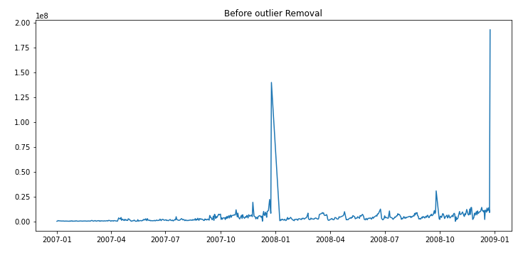
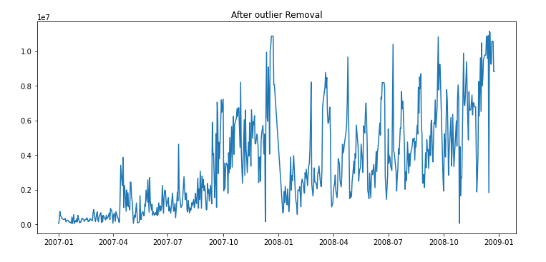
Data Visualization
Outlier Data Points(16)
Outlier Data Points(0)
Source : https://www.sciencedirect.com/science/article/abs/pii/S0957417409004035

Slide 4
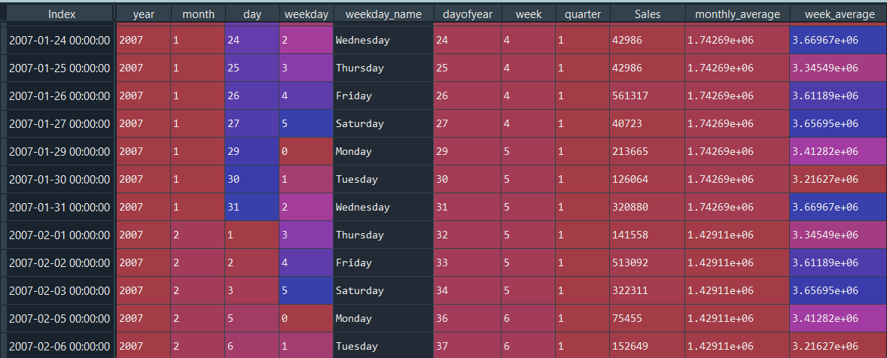
Complete Dataset
Sales Data (587) + Missing Data (137) – Sundays (103) = Total Dataset (621)

Slide 5
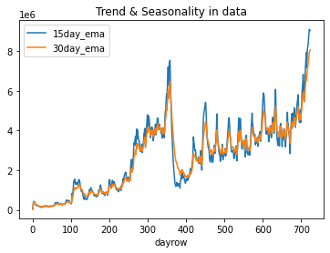
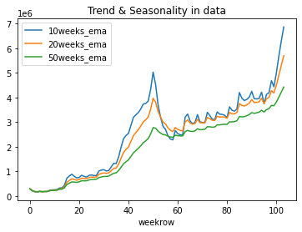
Trend & Seasonality in Data
15, 30-Day Exponential Moving Average
10,20,50-week Exponential Moving Average

Slide 6
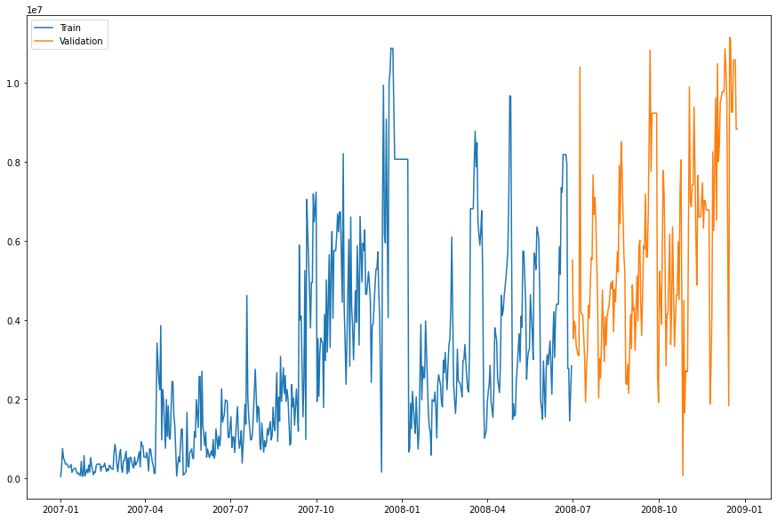
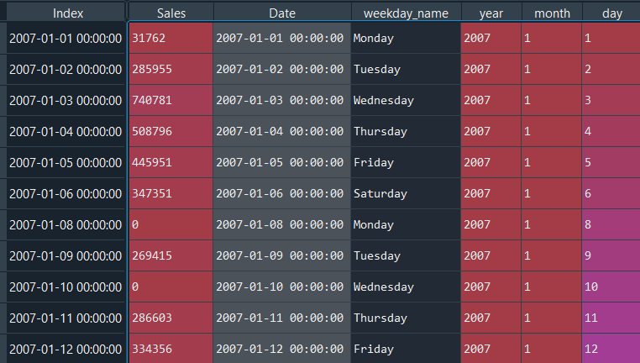
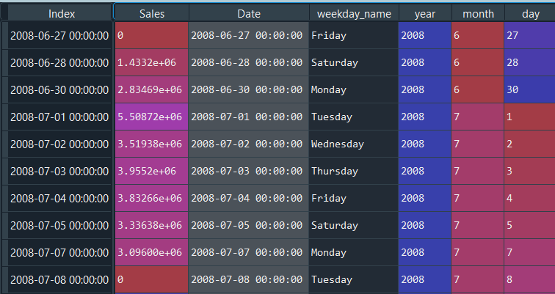
Training & Validation Data
Training & Validation Data plotting
Training Data : 469 Days
75 % Data
Validation Data : 152 Days
25 % Data
To Train the Model
To Validate the Model

Slide 7
1. Holt Winter’s Algorithm
Mathematical Equation
ŷ_{t+1} = Level + Trend + Seasonality
ŷ_{t+1 =} (L_{t} + T_{t}) +S_{t}
ŷ_{t+1} = Level + Trend * Seasonality
ŷ_{t+1 =} (L_{t} + T_{t}) * S_{t}
L_{t}= α (Y_{t} – S_{t-m}) + (1- α) [L_{t-1} + T_{t-1}]
T_{t} = β(L_{t} – L_{t-1}) + (1- β)T_{t-1}
S_{t} = γ (Y_{t} – L_{t}) +(1- γ)S_{t-m}
L_{t}= α (Y_{t} / S_{t-m}) + (1- α) [L_{t-1} + T_{t-1}]
T_{t} = β(L_{t} – L_{t-1}) + (1- β)T_{t-1}
S_{t} = γ (Y_{t} / L_{t}) +(1- γ)S_{t-m}
ŷ_{t+1} = Next Prediction value
Y_{t} = current observation value
Level component (α)
Trend component (β)
Seasonal component (γ)

Slide 8
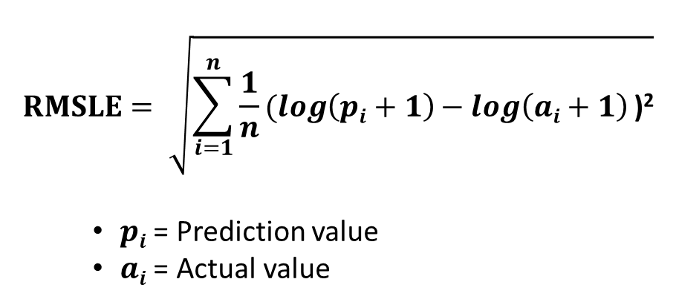
Model Preparation
α = [0.1, 0.3, 0.5, 0.8]
β = [0.001, 0.001, 0.05]
γ = [0.2, 0.4, 0.6]
Total Combination : 36
Best Combination :- α = 0.1, β = 0.001, γ = 0.2
Root Mean Squared Log Error
$$RMSLE= \sqrt{\sum_{i=1}^{n}{\frac{1}{n}(\log\left(pi+1\right)− log\left(ai+1\right)}\text{)}\text{2}}$$
$pi$ = Prediction value
$ai$ = Actual value

Slide 9
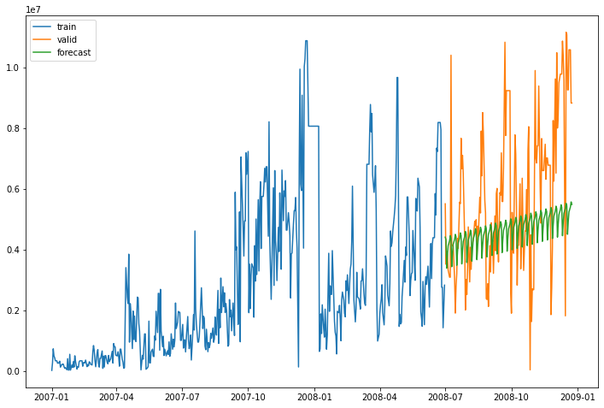
Holt Winter’s Validation
RMSLE : 58.26

Slide 10
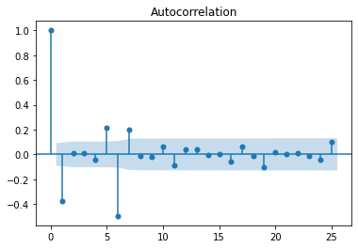
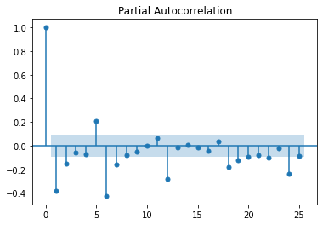
2. SARIMA Model
Parameters of SARIAM models (P,D,Q,s)
P : Seasonal Auto-regressive term
D : Seasonal difference value
Q : Seasonal moving average term
s : number of time steps for a single period
q:Moving Average term
p:Auto Regressive term
Autocorrelation Function
Partial Autocorrelation Function

Slide 11
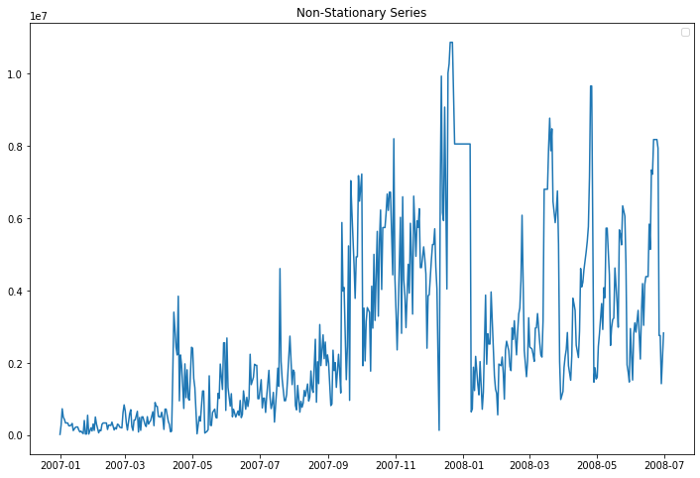
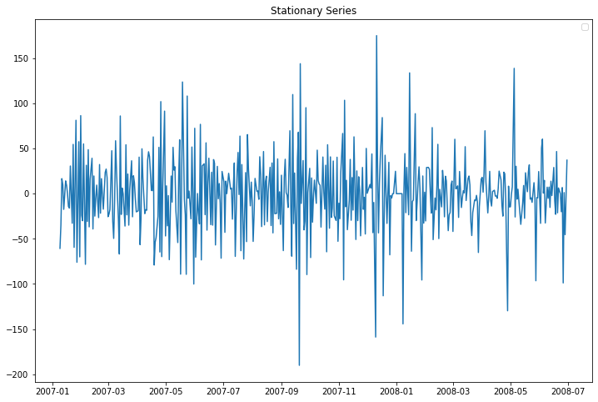

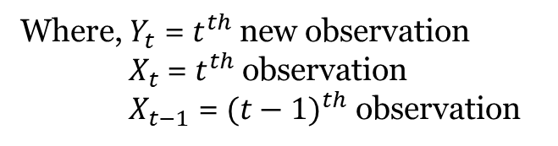
Differencing
Non-Stationary Series
Stationary Series
$Y_{t}=X_{t} −X_{t−1}$
Where, $Y_{t}$ = $t^{th}$ new observation
$X_{t}$= $t^{th}$ observation
$X_{t−1}$ = ${(t−1)}^{th}$ observation

Slide 12
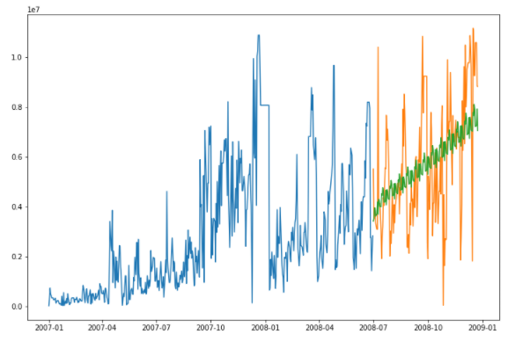
SARIMA model Validation
RMSLE : 57.59

Slide 13

3. Linear Regression Model
Simple Linear Regression :
Multiple Linear Regression :
$$Y=b_{0}+b_{1}∗x_{1}$$
$$Y=b_{0}+b_{1}∗x_{1}+b_{2}∗x_{2} + . . . . . . . .+ b_{n}∗x_{n}$$
Month (x1)
Year (x2)
“Retail daily Sales” (y)
Quarter (x3)
Day (x4)
Week day (x5)
Day of Year (x6)
$$Y=b_{0}+b_{1}∗x_{1}+b_{2}∗x_{2} +b_{3}∗x_{3}+b_{4}∗x_{4}+b_{5}∗x_{5}+b_{6}∗x_{6}$$

Slide 14
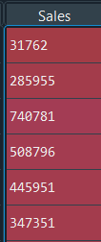
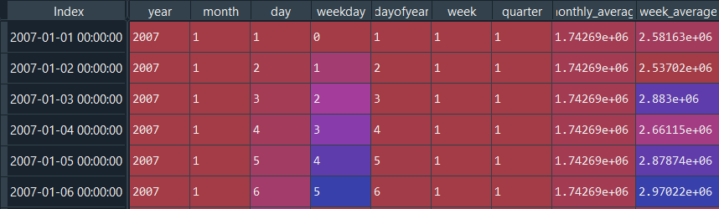
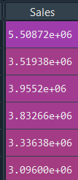
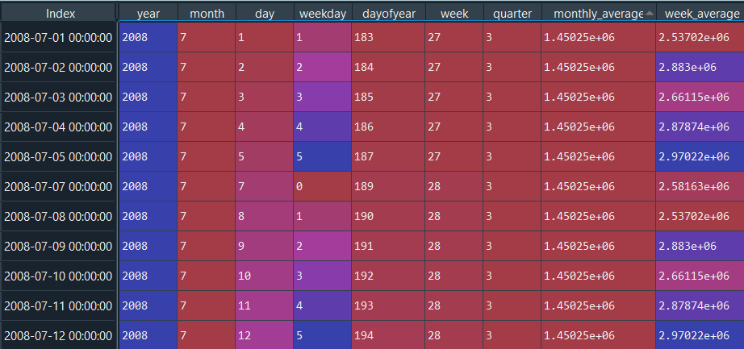
Training & Validation dataset
Y
X
Training
469 data
Validation
152 data

Slide 15
Ridge Regression
Ridge Regression : Extension of linear regression by adding a regularization penalty to the loss function during training.
Penalty (α) : [0.01, 0.05, 0.1, 0.5, 1, 5]
Penalty (α) | RMSLE
0.01 | 60.85
0.05 | 60.14
0.1 | 59.46
0.5 | 57.17
1 | 57.41
5 | 66.49

Slide 16
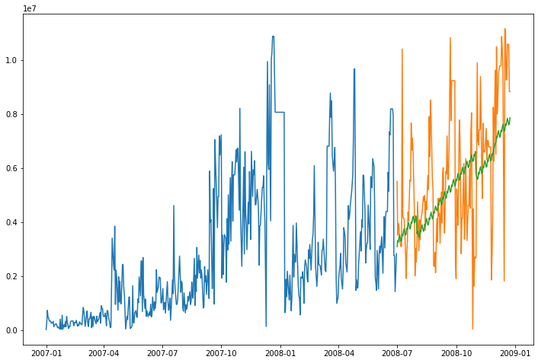
Linear Regression model Validation
RMSLE : 57.17

Slide 17
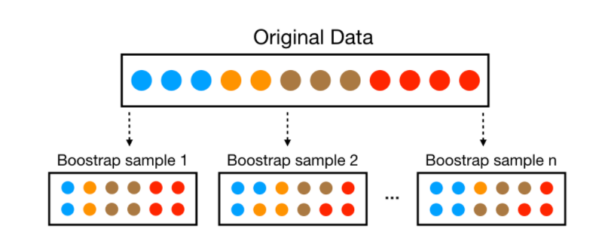
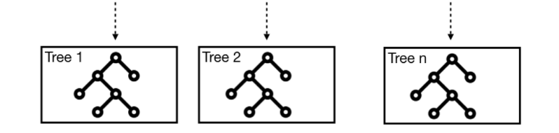
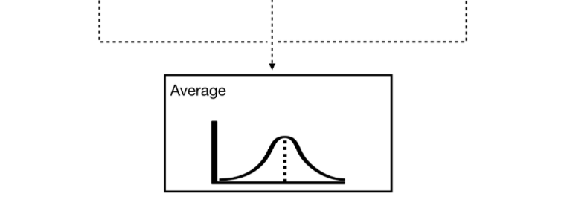
4. Random Forest Model
Create multiple bootstrap samples.
Build a decision tree on every sample.
Feature sampling for each split in
decision tree.
Aggregate all decision trees.
Hyperparameters of random forest
max_features
max_depth
min_samples_split
min_samples_leaf
n_estimators

Slide 18
Model Preparation
n_estimator = [70, 100, 130, 150]
max_depth = [5, 6, 7, 8, 9]
min_samples_split = [20, 30, 50]
Total Combination : 60
Best Combination :- n_estimator = 150, max_depth = 8, min_samples_split = 50.
$$RMSLE= \sqrt{\sum_{i=1}^{n}{\frac{1}{n}(\log\left(pi+1\right)− log\left(ai+1\right)}\text{)}\text{2}}$$
$pi$ = Prediction value
$ai$ = Actual value

Slide 19

Random Forest model Validation
RMSLE : 55.61

Slide 20
Best Model Selection
Model Name | RMSLE
Holt Winter’s Model | 58.26
SARIMA Model | 57.59
Linear Regression Model | 57.17
Random Forest Model | 55.61
Random Forest : n_estimator = 150, max_depth = 8, min_samples_split = 50.

Slide 21
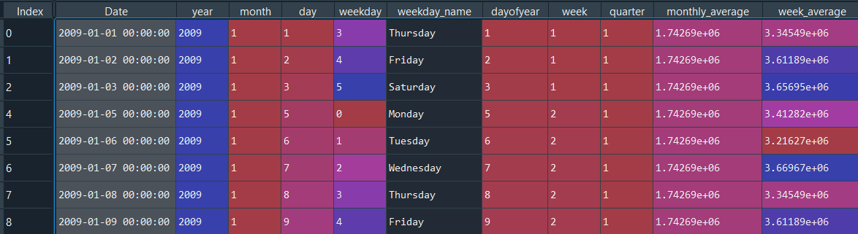
Forecast for Next 6 month Sales
Objective: Sales Forecasting for “2009-01-01” to “2009-06-30”
Model Used :
Random Forest [n_estimator = 150, max_depth = 8, min_samples_split = 50]

Slide 22
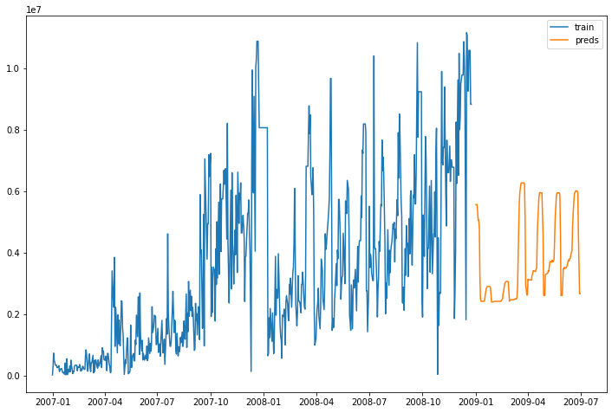
Prediction plot for Next 6 Month
Sales Forecasting for “2009-01-01” to “2009-06-30”

Slide 23
References
Hofmann, E., & Rutschmann, E. (2018). Big data analytics and demand forecasting in supply chains: a conceptual analysis. The International Journal of Logistics Management, 29(2), 739–766.
Huber, J., Gossmann, A., & Stuckenschmidt, H. (2017). Cluster-based hierarchical demand forecasting for perishable goods. Expert Systems with Applications, 76, 140–151.
Van Donselaar, K. H., Gaur, V., Van Woensel, T., Broekmeulen, R. A., & Fransoo, J. C. (2010). Ordering behavior in retail stores and implications for automated replenishment. Management Science, 56(5), 766–784.
Van Donselaar, K., van Woensel, T., Broekmeulen, R., & Fransoo, J. (2006). Inventory control of perishables in supermarkets. International Journal of Production Economics, 104(2), 462–472.
Ahmed, N.K., Atiya, A.F., Gayar, N.E. and El-Shishiny, H., 2010. An empirical comparison of machine learning models for time series forecasting. Econometric Reviews, 29(5-6), pp.594-621.
Makridakis, S., Spiliotis, E. and Assimakopoulos, V., 2018. Statistical and Machine Learning forecasting methods: Concerns and ways forward. PloS one, 13(3), p.e0194889.
Crone, S.F., Hibon, M. and Nikolopoulos, K., 2011. Advances in forecasting with neural networks? Empirical evidence from the NN3 competition on time series prediction. International Journal of forecasting, 27(3), pp.635-660.
Chu, C.W. and Zhang, G.P., 2003. A comparative study of linear and nonlinear models for aggregate retail sales forecasting. International Journal of production economics, 86(3), pp.217-231.
Crone, S.F. and Kourentzes, N., 2009, July. Forecasting Seasonal Time Series with Multilayer Perceptrons-An Empirical Evaluation of Input Vector Specifications for Deterministic Seasonality. In DMIN (pp. 232-238).
Aburto, L. and Weber, R., 2007. Improved supply chain management based on hybrid demand forecasts. Applied Soft Computing, 7(1), pp.136-144.

